Slide 1
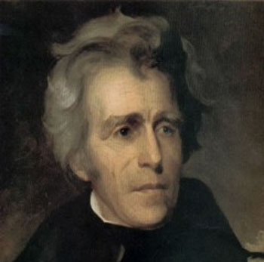
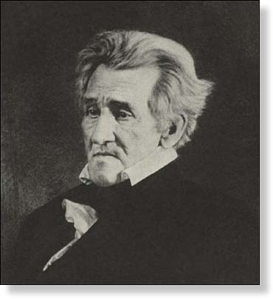
Chapter 13
The Rise of Mass Democracy, 1824-1840
Telling the Story

Slide 2
Tell the Story of…
2nd 2-party system
Election of 1824
“corrupt bargain”
Henry Clay
John Quincy Adams

Slide 3
Tell the Story of…
National Republicans
Democratic-Republicans
Election of 1828
“Old Hickory”
“King Mob”
spoils system

Slide 4
Tell the Story of…
Tariff of Abominations (1828)
John C. Calhoun
The South Carolina Exposition
states’ rights
Tariff of 1832
ordinance of nullification
Compromise tariff of 1833
Force Bill

Slide 5
Tell the Story of…
Society for Propagating the Gospel Among Indians (1787)
Sequoya
Five Civilized Tribes
Indian Removal Act (1830)
Black Hawk War (1832)
Bureau of Indian Affairs (1836)
Osceola and the Seminole Wars (1837)
Trail of Tears

Slide 6
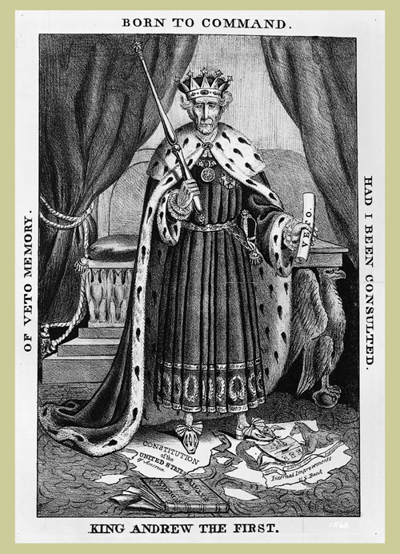
King Andrew

Slide 7
Tell the Story of…
Nicholas Biddle
Veto of renewal of the Bank charter (1832)
The “Bank War”
“pet banks”
Specie Circular
Panic of 1837

Slide 8
Tell the Story of…
Election of 1832
Anti-Masonic Party
national nominating conventions
“King Andrew”
Whigs
internal improvements

